Slide 1
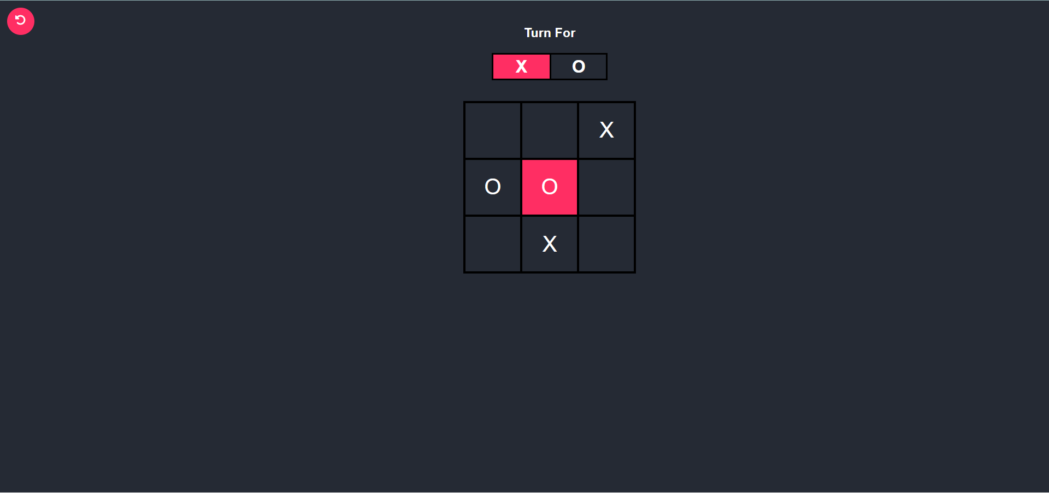


How to play:
player
using to play

